Slide 1
CIS 500: Data Analysis and Decision Testing
US Elections Result Analysis from 1976 to 2020
Ayush Saxena(573647550) Brijesh Verma(826257344)
Hemil Shah(610010477)

Slide 2
Presentation Outline
Problem Statement
Significance
Problem Description
Development Methodology
Results
Conclusion
Future Research

Slide 3
Problem Statement
Understanding the dynamics behind USA election results is crucial for political strategists, policymakers, and the public alike. With the vast amount of data spanning from 1970 to 2020, there's a pressing need to dissect and analyze these elections comprehensively. However, the complexity of factors influencing election outcomes presents a formidable challenge. Identifying these factors and understanding their interplay is pivotal for enhancing our understanding of the electoral process.

Slide 4
Significance
Informing Political Strategy: By delving into past election data, we can uncover patterns and trends that inform political strategies. This understanding allows for more effective campaign planning and resource allocation.
Enhancing Public Understanding: Providing insights into the factors shaping election results fosters a better-informed electorate. Understanding the dynamics of elections empowers voters to make more educated choices.
Predictive Analysis: Developing a methodology for predicting future election outcomes based on historical data enables stakeholders to anticipate electoral trends. This predictive capability is invaluable for shaping political campaigns and policy agendas
Fostering Democratic Participation: Through comprehensive analysis, we aim to encourage greater participation in the democratic process. By elucidating the factors influencing election outcomes, we empower citizens to engage meaningfully in the electoral process.
Academic and Policy Relevance: This analysis contributes to academic research and informs policy discussions surrounding electoral reform and governance. By shedding light on past election trends, we can guide future policy decisions aimed at strengthening democratic institutions.

Slide 5
Problem Description
The aim is to perform exploratory data analysis (EDA) on the US presidential election
data from 1976 to 2020, consolidated from all states.
The primary objectives are:
1. Analyze the election results across different political parties over the years.
2. Investigate the state-level voting patterns and trends. We chose this analysis because we wanted to cover most interesting history of USA Elections and to see behaviour of several states over the years and to determine which are the SWING states.
3. To look out for the most famous individual who stood in the USA presidency candidacy history.

Slide 6
Development Methodology
1. Data Preprocessing
2. Exploratory Data Analysis
Load and preprocess the US presidential election dataset, handling any missing values or inconsistencies
Read data from CSV file and performed cleaning and transformation
Used EDA Functions to compute summary statistics, generate visualizations (e.g., histograms, scatter plots), and identify patterns or outliers in the data.
Visualizing the data using various plots and charts (e.g., line plots, bar charts, scatter plots)

Slide 7
Development Methodology
3. Data Visualization
4. Metric Analysis
Leveraged libraries like Plotly and BokehJS to create interactive and animated visualizations, enabling users to explore the data dynamically
Line plots to depict the vote share of parties over time
Choropleth maps to visualize state-level voting patterns
Animated plots to showcase the evolution of voting trends across elections
Employed relevant statistical metrics and techniques to quantify and evaluate the analysis results, such as:
Calculating vote shares and vote margins for different parties
Measuring the correlation between various factors (e.g., demographics, economic indicators) and voting patterns
Performing hypothesis testing to assess the significance of observed trends or differences

Slide 8
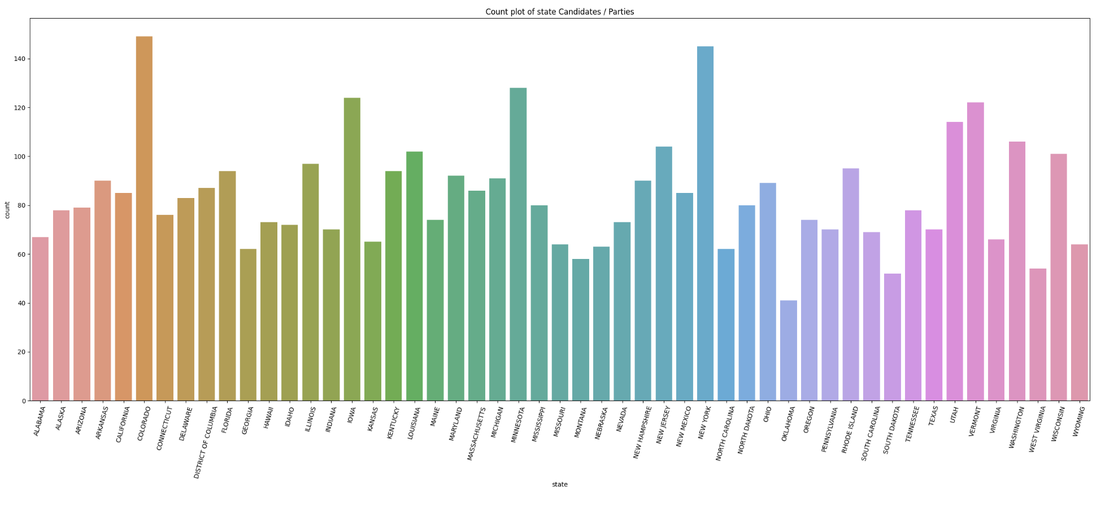
Results
The following count plot shows number of state candidates for each party

Slide 9
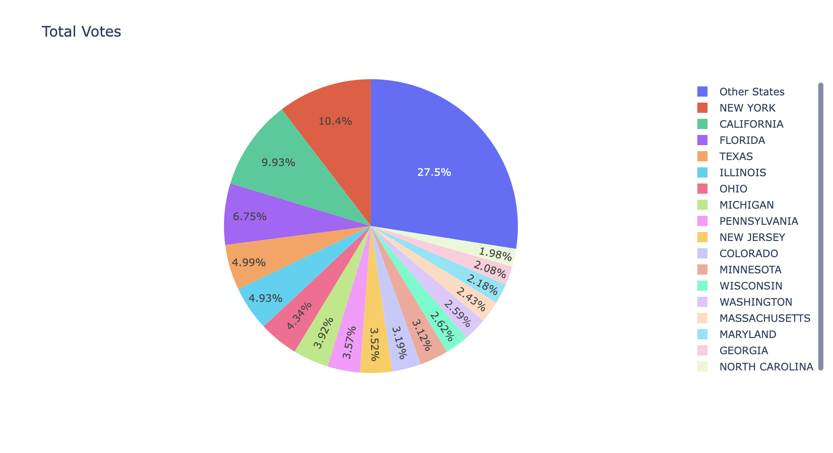
The following pie chart represents division of total votes casted across USA in 44 years

Slide 10
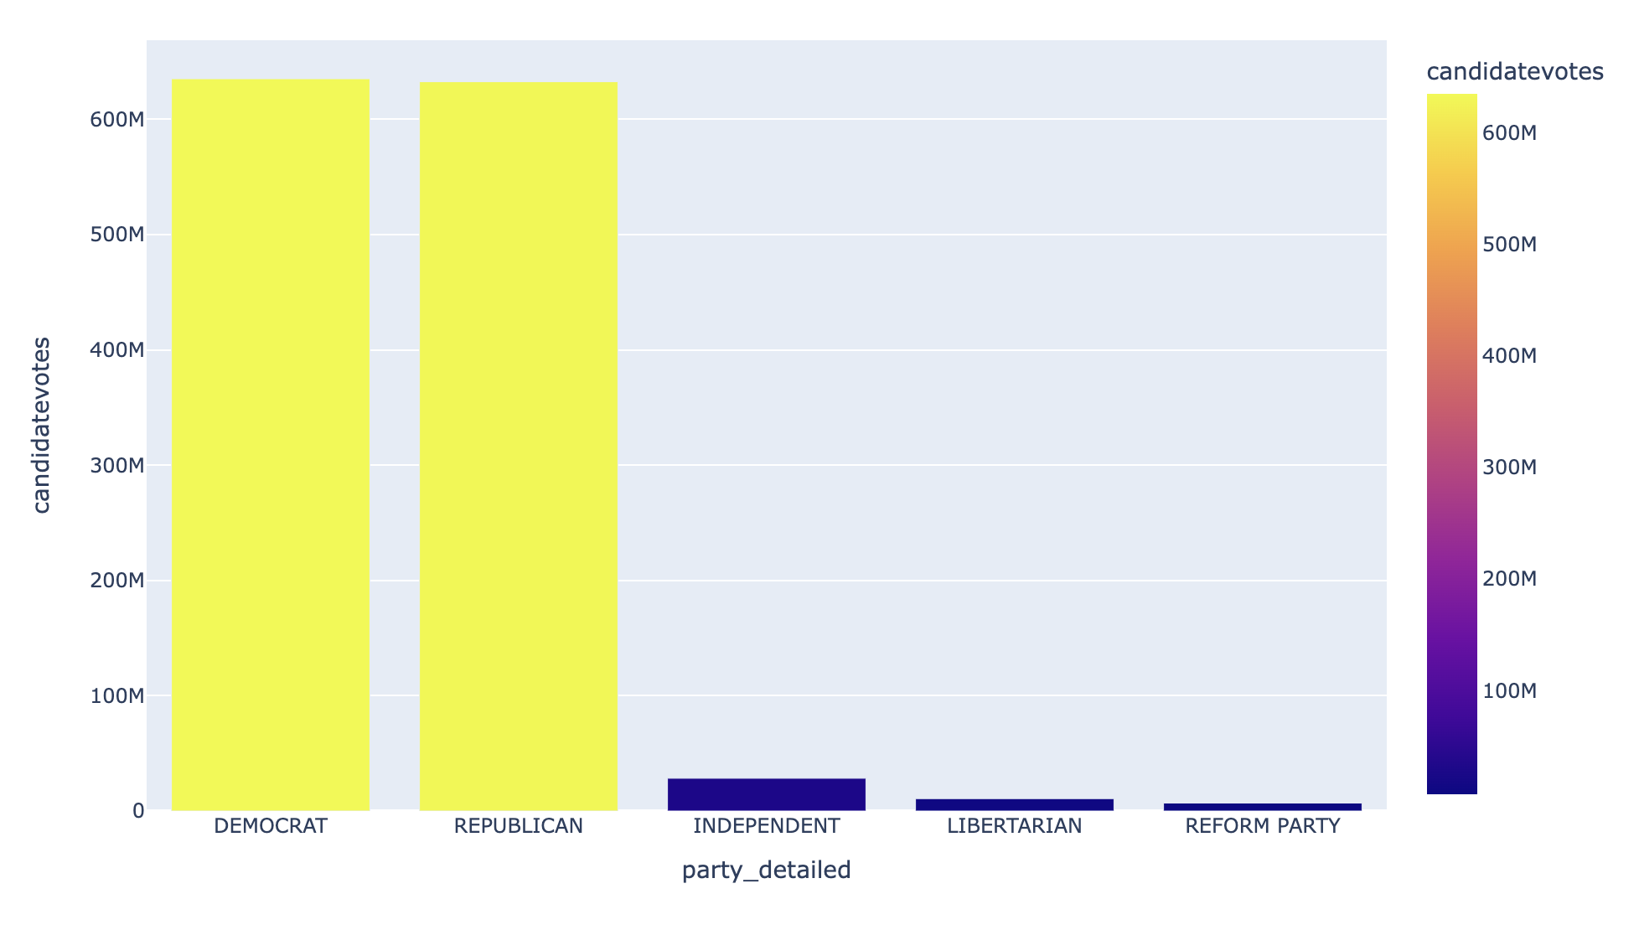
The following bar plot very clearly showcases top 5 dominant parties in USA Election history in span of 44 years

Slide 11
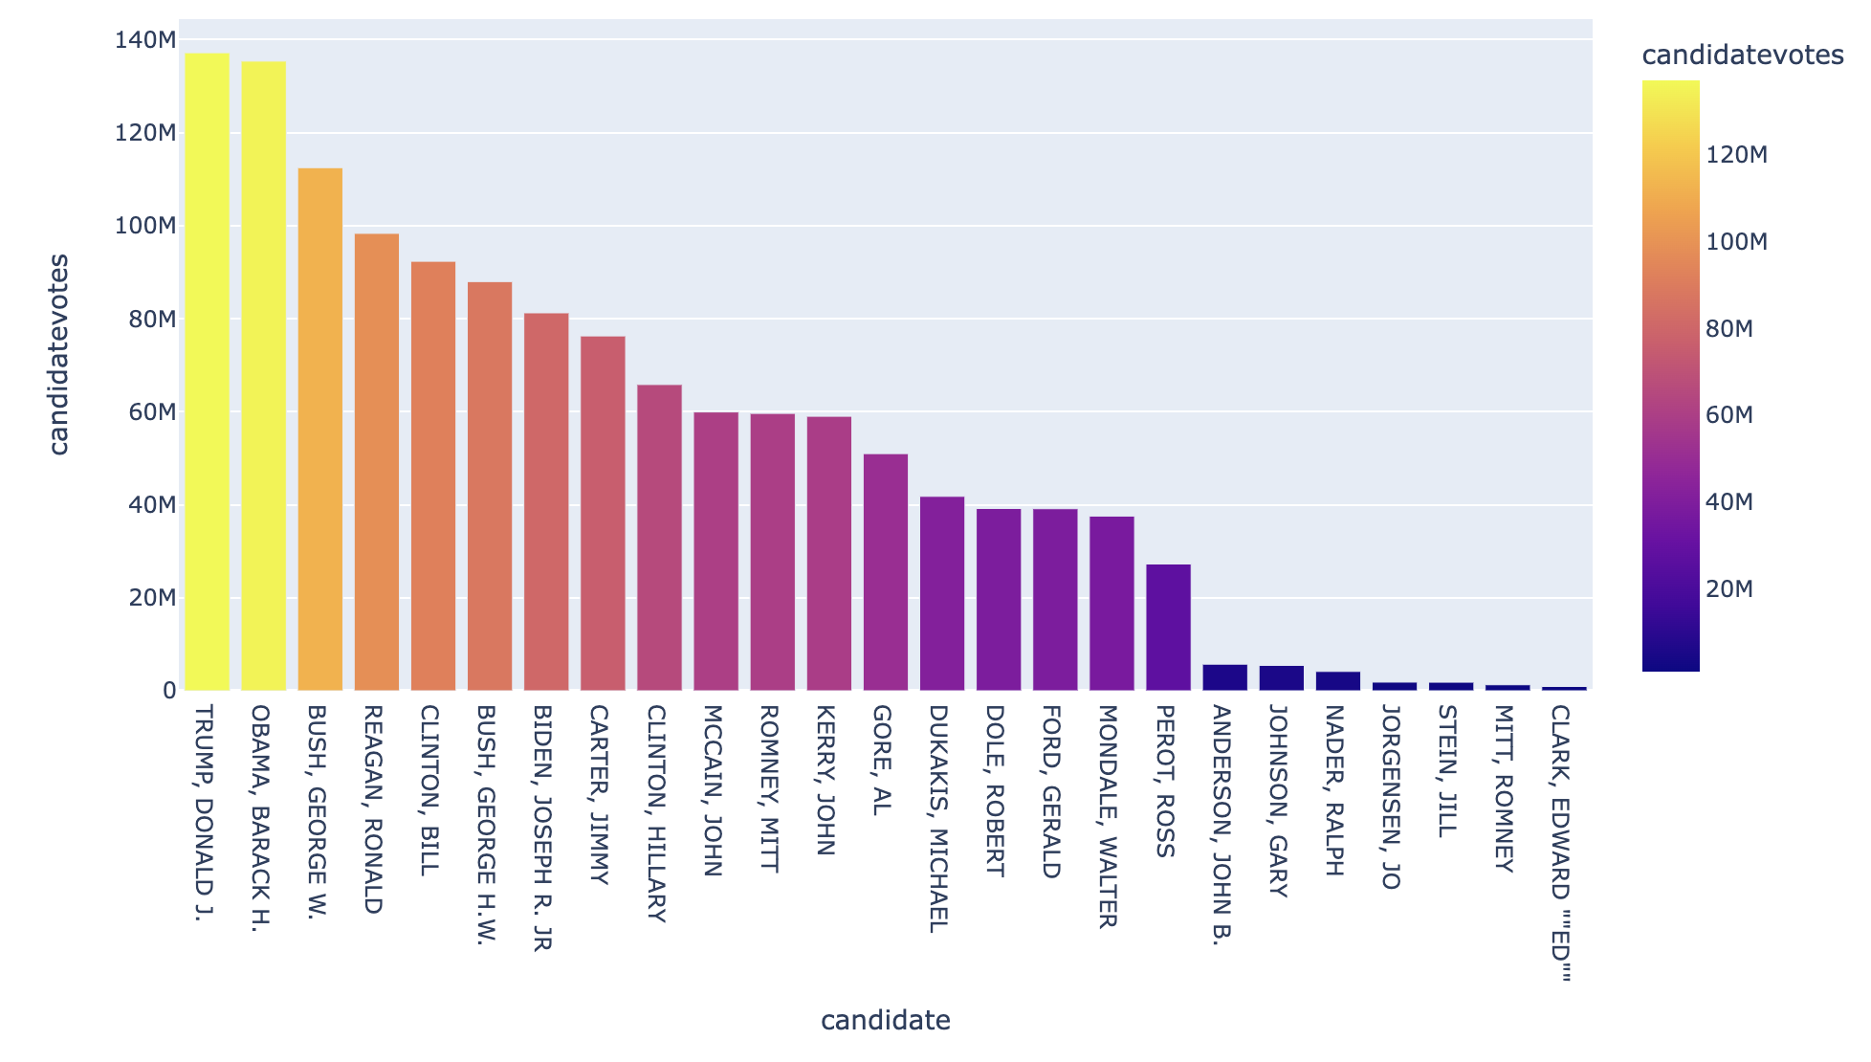
The following bar graph shows which candidates got most votes in USA Election history

Slide 12
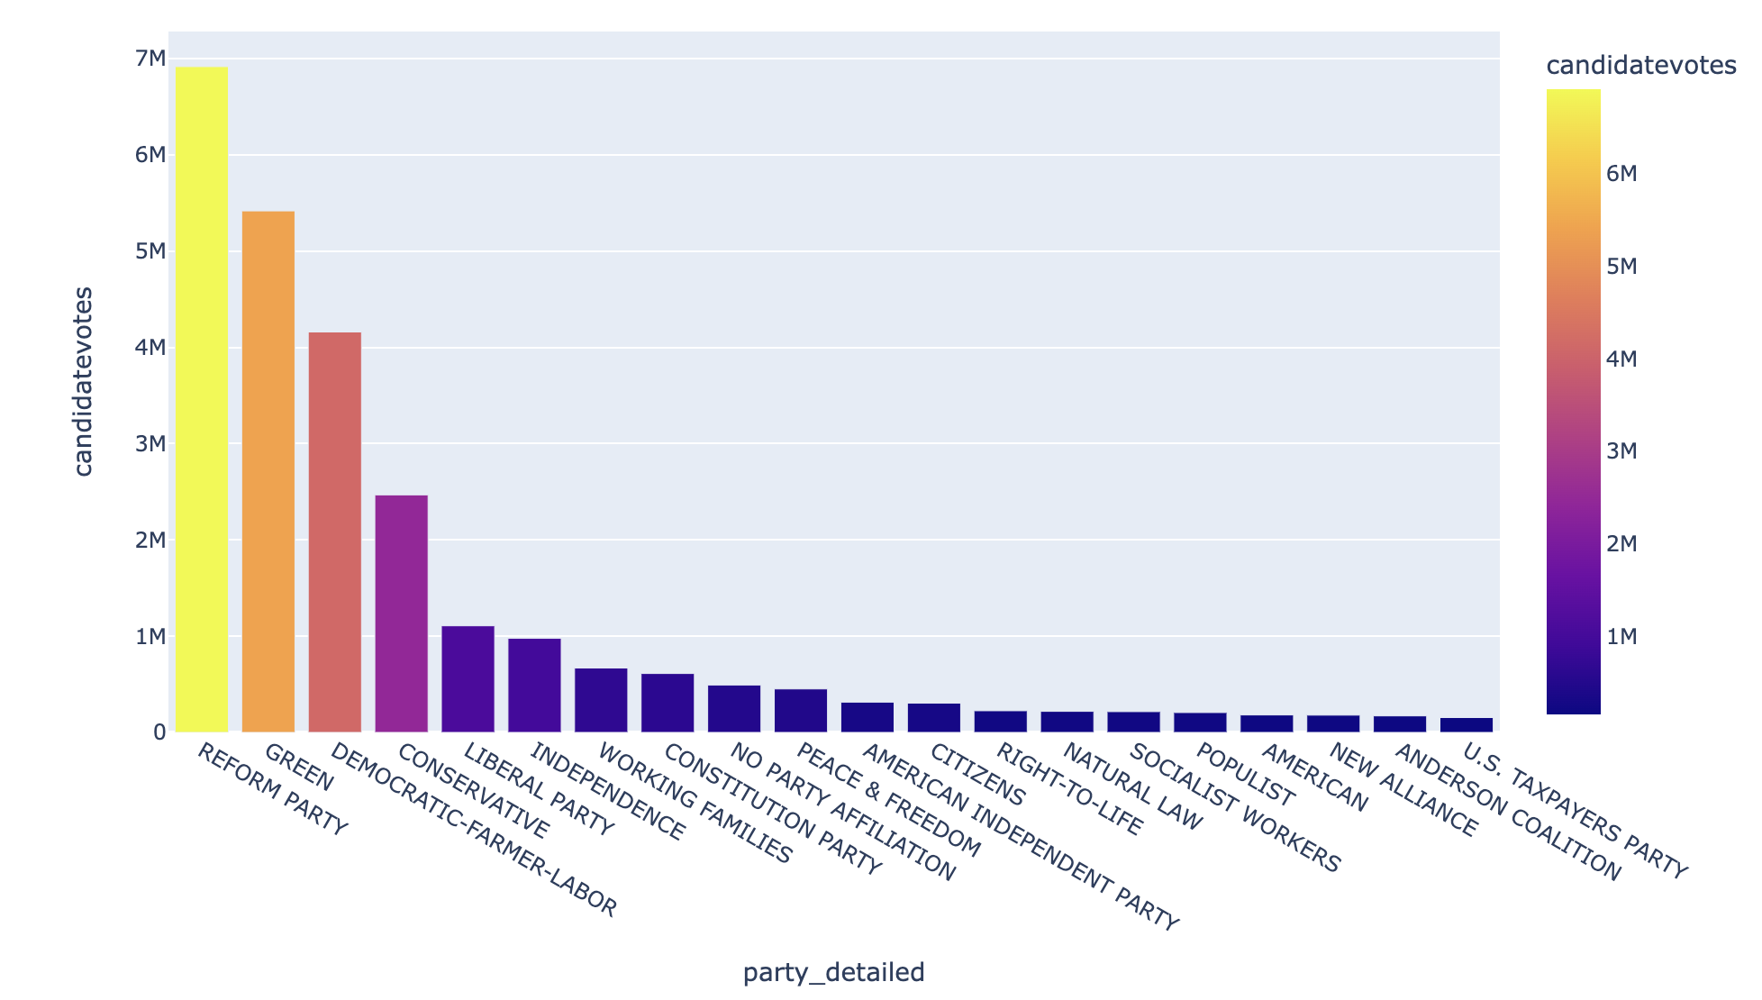
The following plot shows dominance of non-major top 5 parties during the span of 44 years where Reform party is leading by a huge margin

Slide 13
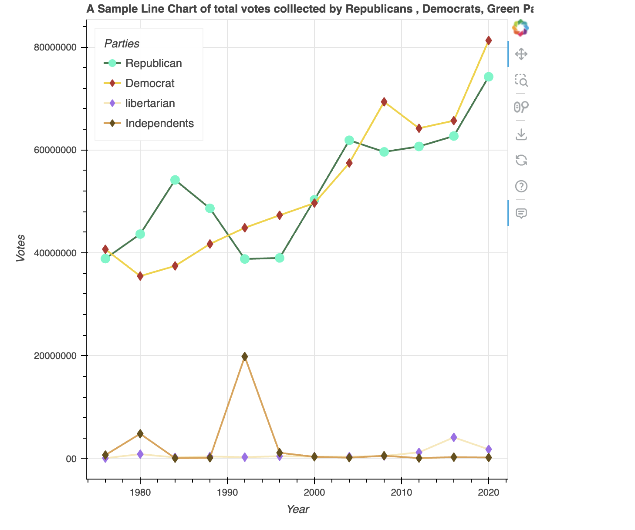

Slide 14
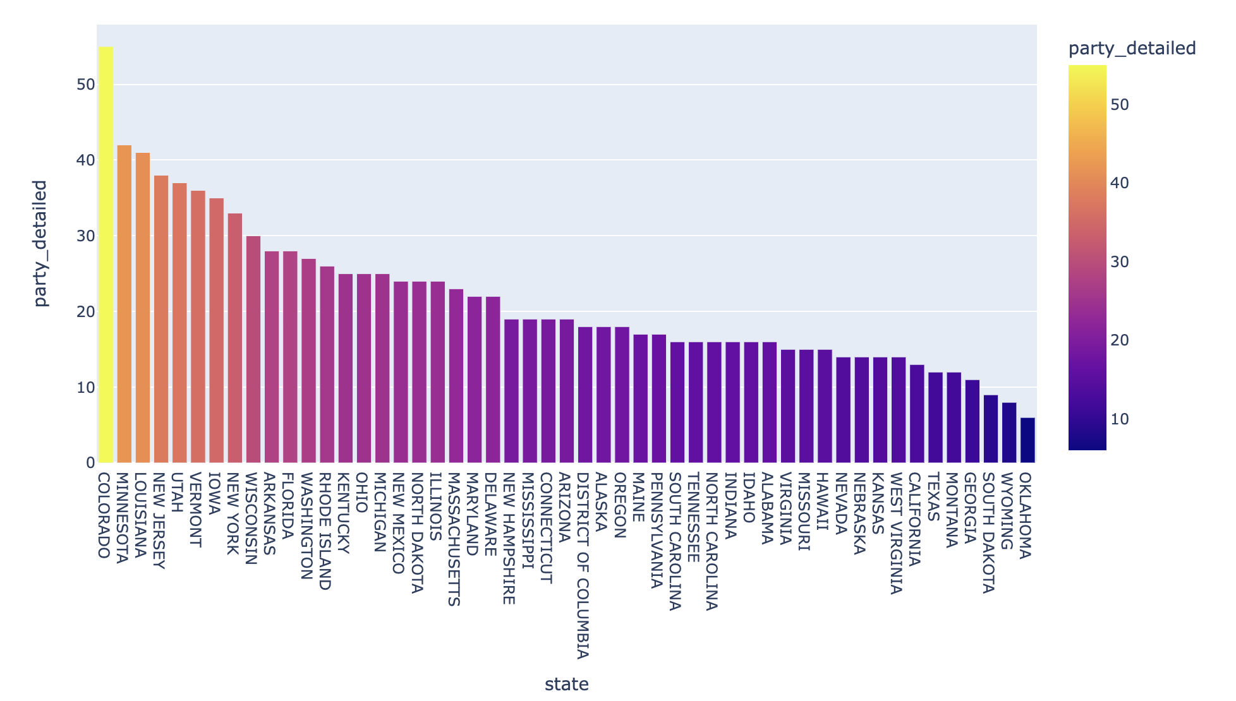
The following bar plot shows number of unique parties with each state aligned in decreasing order

Slide 15
Conclusions
Based on the analysis, we drew many conclusions about the US presidential election
trends, party dynamics, and state-level voting behaviors.
We found out New York and California are the most important states as far as total contribution in elections is concerned over the span of 44 years.
Donald J. Trump has been the most influential leader so far followed by Barack H. Obama.
Democrat and Republicans are the only two major parties dominating elections way far than any other party in the history of USA Elections. Although Democrats are found to be slightly ahead then Republicans.
Colorado has been the state with most number of unique parties so far followed by New York.
There are few battleground states(SWING) which mostly decide the fate of candidates, some of them are Pennsylvania, Wisconsin and Illinois.

Slide 16
Future Research
Although we came up for the solutions of our problem statement, but there is always scope for development, some of them could be:
Incorporating additional data sources, such as demographic data, economic indicators, and polling data, to gain deeper insights into voter behavior.
Developing predictive models to forecast election outcomes based on historical data and relevant factors.
Exploring advanced data visualization techniques, such as interactive dashboards or virtual reality environments, to enhance the presentation and understanding of election data.
Investigating potential discrepancies or biases in the data collection and analysis processes, and proposing methods to mitigate them.

Slide 17
References
Kaggle
MIT Election Lab Dataset
Google.com
Wikipedia

Slide 18
Thank you

